Slide 1
Take 10 with 4-H
NM 4-H Adult Retreat
(formerly Forum)

Slide 3
When and Where

Slide 4
What
Great opportunity for 4-H volunteers, parents and agents to learn, network and get energized.
Fun day of workshops, networking, speakers and make and take.
https://nm4h.nmsu.edu/volunteer/adult.html

Slide 5
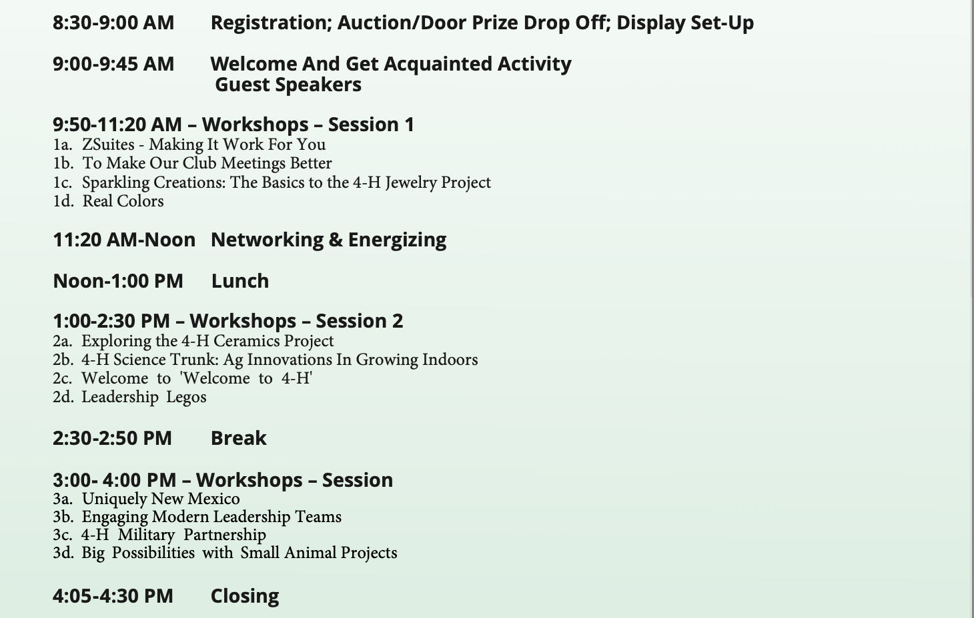

Slide 6
How Much
Early bird registration of $40 is available until October 15 and after that registration will be $50.
T-shirts can be order with registration for $20.
Scholarships
First Timer
Gerry Copeland
How to Register
Online Registration Link
https://ezregister.com/events/40819/

Slide 7
Thank you!!

